Slide 1


VULNERABILITY ASSESMENT &
PENETRATION TESTING

Slide 2
$ outline
Virtual Lab Setup

Slide 3
$ qtd
“do not over-estimate how much you can achieve in the short term and under-estimate how much you can achieve in the long-term”
Learning is a process …

Slide 4
$ objectives
Understand virtualization/hypervisors
Install VirtualBox/VMWare
Understand/execute hypervisor operations – snapshot, pause, clone, export, import
Network/Configure VirtualBox network
Install/manage virtual OS
Understand structure of Windows/Linux OS

Slide 5
$ Virtualization
Virtualization ?
Virtualization relies on software to simulate hardware functionality and create a virtual computer system.
A thin layer of software called a “hypervisor” decouples the virtual machines from the host and dynamically allocates computing resources to each virtual machine as needed.
Virtualization include interaction between Host and Guest systems
Notes:
Reference
https://www.vmware.com/solutions/virtualization.html#:~:text=Virtualization%20relies%20on%20software%20to,of%20scale%20and%20greater%20efficiency.

Slide 6
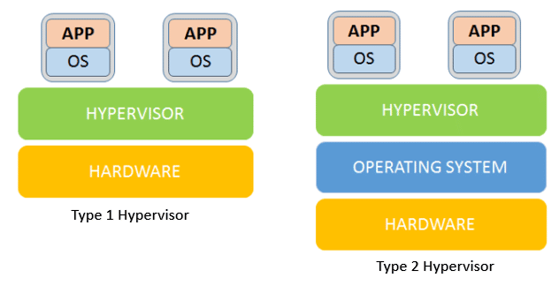
$ Virtualization
What types ?
Notes:
Type 1 also called Bare Metal
Type 2 also called Hosted Hypervisors
TASK:
Research on the examples of Type 1 and Type 2 hypervisors and their use cases.

Slide 7
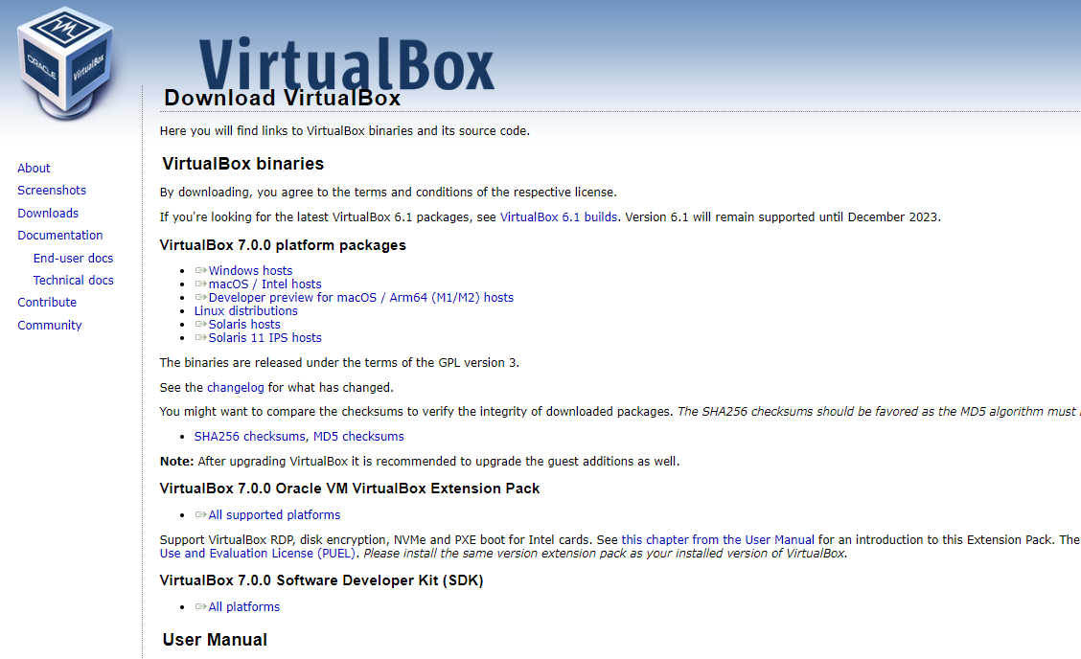

$ Virtualization | Installing VirtualBox
Download latest setup from original website:
https://www.virtualbox.org/wiki/Downloads
Also, download VirtualBox Extension Pack https://download.virtualbox.org/virtualbox/7.0.0/Oracle_VM_VirtualBox_Extension_Pack-7.0.0.vbox-extpack
Notes:
Note: You can work with other virtualization programs like VMWare.

Slide 8
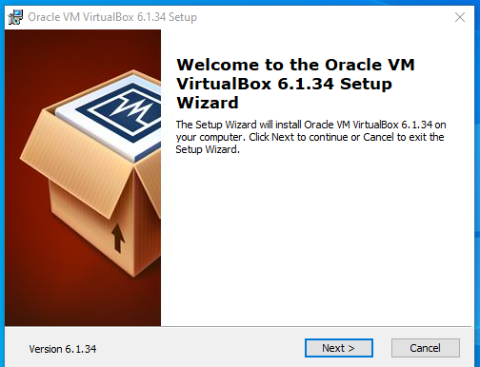
$ Virtualization | Installing VirtualBox
Run installer package and follow prompts to complete installation (maintain defaults)
Notes:
You can leave the default options to complete installation unless otherwise.

Slide 9
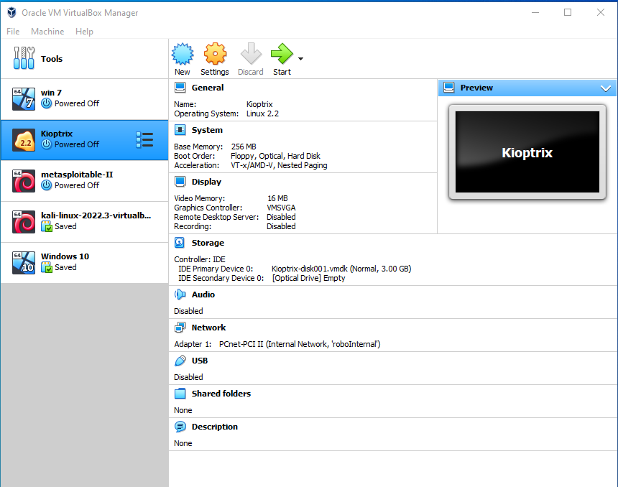
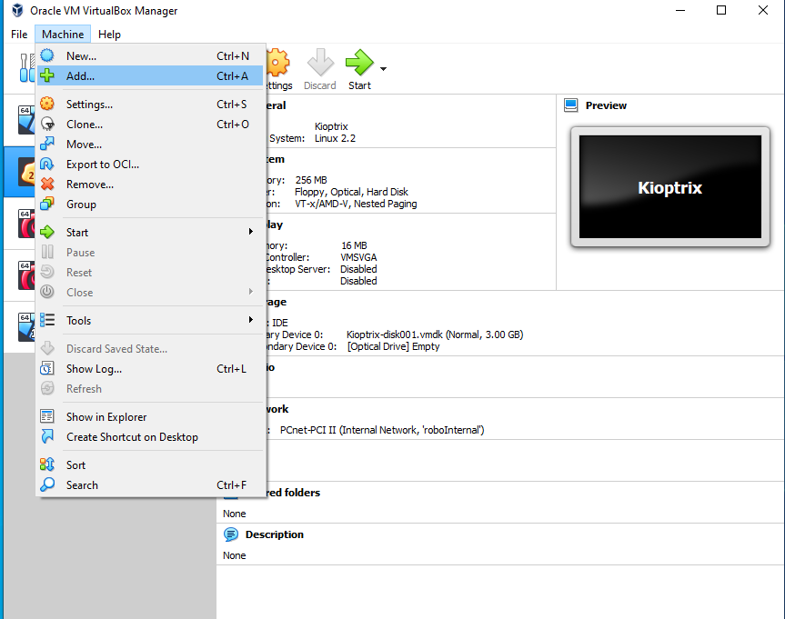
$ Virtualization | Installing Guest OS
1
2
> Click on Machine and Add

Slide 10
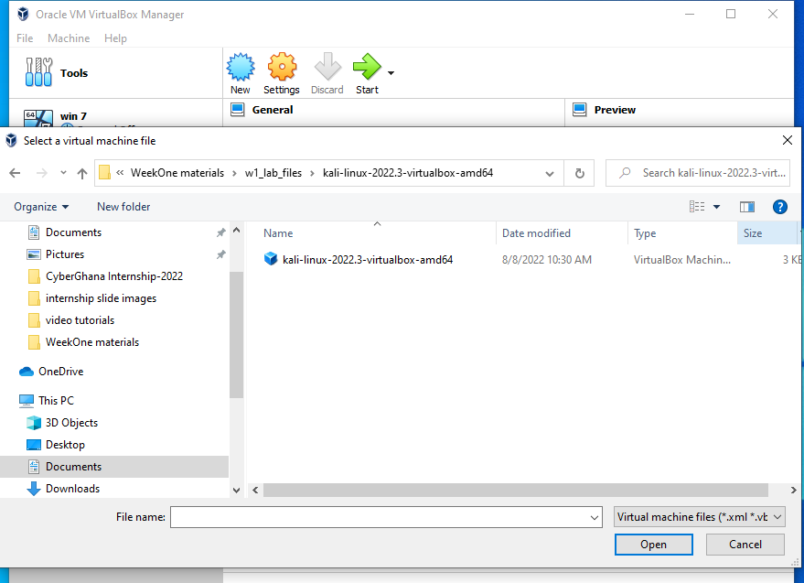
$ Virtualization | Installing Guest OS
3
4
> Follow prompts to complete Adding Machine
> Navigate to the location of the VirtualBox Machine Definition file

Slide 11
$ Virtualization | VirtualBox Terms
Clone
Save state
Move
Import
Export
Snapshot
Other requirements:
Install Guest Additions
want more info? refer to man
https://www.virtualbox.org/manual/ch04.html#guestadd-intro
Notes:
https://www.virtualbox.org/manual/ch04.html#guestadd-intro

Slide 12
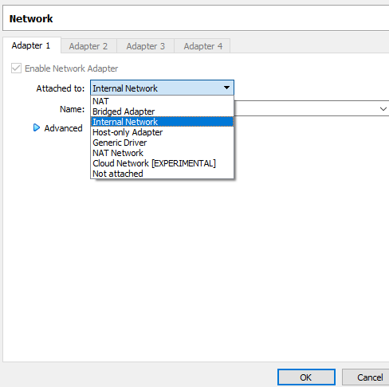
$ Virtualization | Virtual Networking | Networking Modes
Oracle VM VirtualBox supports up to 8 virtual adapters.
Commonly used for our labs:
NAT
NAT Network
Internal Network
Refer to manual
https://www.virtualbox.org/manual/ch06.html
Notes:
https://www.virtualbox.org/manual/ch04.html#guestadd-intro

Slide 13
$ Lab Instruction
Install VirtualBox
Add Kali Linux Virtual Machine
Install VirtualBox Guest Additions
Notes:
https://www.virtualbox.org/manual/ch04.html#guestadd-intro

